Slide 2
Intro to Microsoft Power Platform with Hands-on Session on Power Pages
Sharda Kaur

Slide 3
The 3As
Analyze
Act
Automate

Slide 4
Advantages
Efficient and productive
Time-saving
Cost effective
Low code/ no code

Slide 5
Features
AI Builder lets users and developers add AI capabilities to the workflows and Power Apps they create and use. AI Builder is a viable solution that allows you to easily add intelligence to your workflows and apps and predict outcomes to help improve business performance without writing code.
Microsoft Dataverse is a scalable data service and app platform which lets users securely store and manage data from multiple sources and integrate that data in business applications using a common data model to ensure ease and consistency to users. Microsoft Dataverse is the common currency that enables the components of Microsoft Power Platform to work together. It’s the foundation that enables the consolidation, display, and manipulation of data.
Notes:
Multiple sources include the main two forms.
Tabular data and function based data.

Slide 6


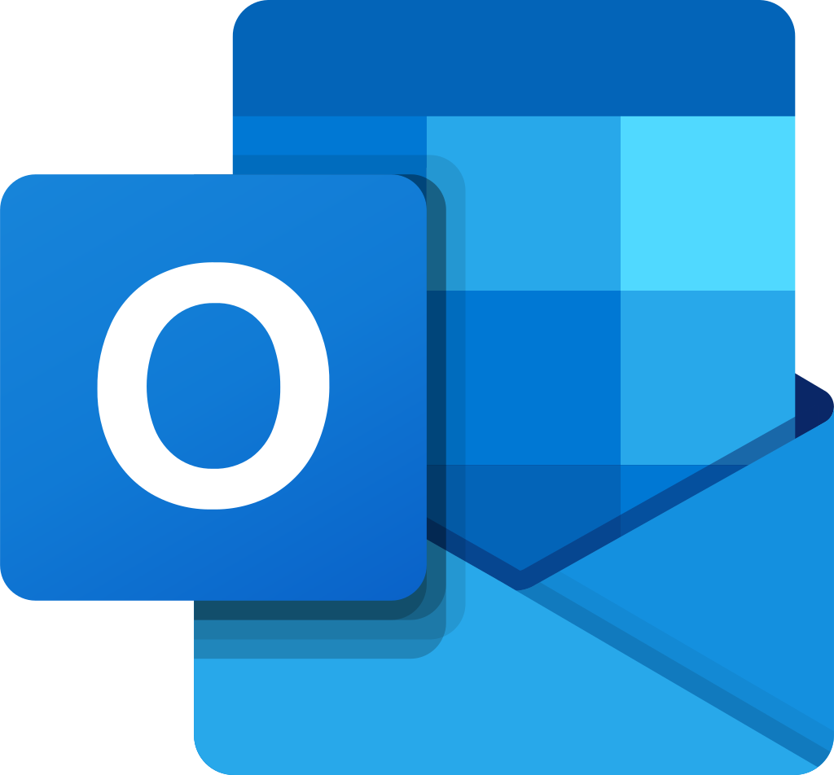
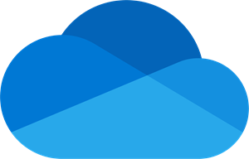

Connectors enable you to connect apps, data, and devices in the cloud. Consider connectors the bridge across which information and commands travel. There are more than 275 connectors for Microsoft Power Platform, enabling all of your data and actions to connect cohesively. If the connectors don’t meet your requirements or you need a specific one for your enterprise, Power Automate offers you the opportunity of creating a custom connector to work with your data.

Slide 7
Security Policies
Your organization's data is likely one of the most important assets you are responsible for safeguarding as an administrator. The ability to build apps and automation to use that data is a large part of your company's success. You can use Power Apps and Power Automate for rapid build and rollout of these high-value apps so that users can measure and act on the data in real time. Apps and automation are becoming increasingly connected across multiple data sources and multiple services. Some of these might be external, third-party services and might even include some social networks. Users generally have good intentions, but they can easily overlook the potential for exposure from data leakage to services and audiences that should not have access to the data.
Whether for personal or corporate use, you can enact measures that will keep your
data safe.

Slide 8
Power Automate

Slide 9


A better and automatic way to get things done
A cloud-based system that turns manual tasks into automated workflows
Offers API-based automation to connect multiple applications together
A system to simplify complex processes and manage them effectively
Formerly known as Microsoft Flow

Slide 10
Templates
Power Automate has loads of predesigned flows for daily tasks. From setting alarms so that you don’t miss that early morning meeting to uploading your email attachments to a specific folder, Power Automate has got you covered.
If you don’t find what you want from the exhaustive list, you can create yours from scratch with triggers and connectors of your choice.

Slide 11
Triggers & Actions
Triggers are specific to Power Automate and prompt a flow to begin. Triggers can be time based, such as a flow which begins every day at 8:00 am, or they could be based off of an action like creating a new row in a table or receiving an email. You will always need a trigger to tell your workflow when to run.
Actions are used in Power Automate and Power Apps. Actions are initiated by the user or a trigger and allow interaction with your data source by some function. For example, an action would be sending an email in your workflow or app or writing a new line to a data source.
Trigger Action

Slide 12
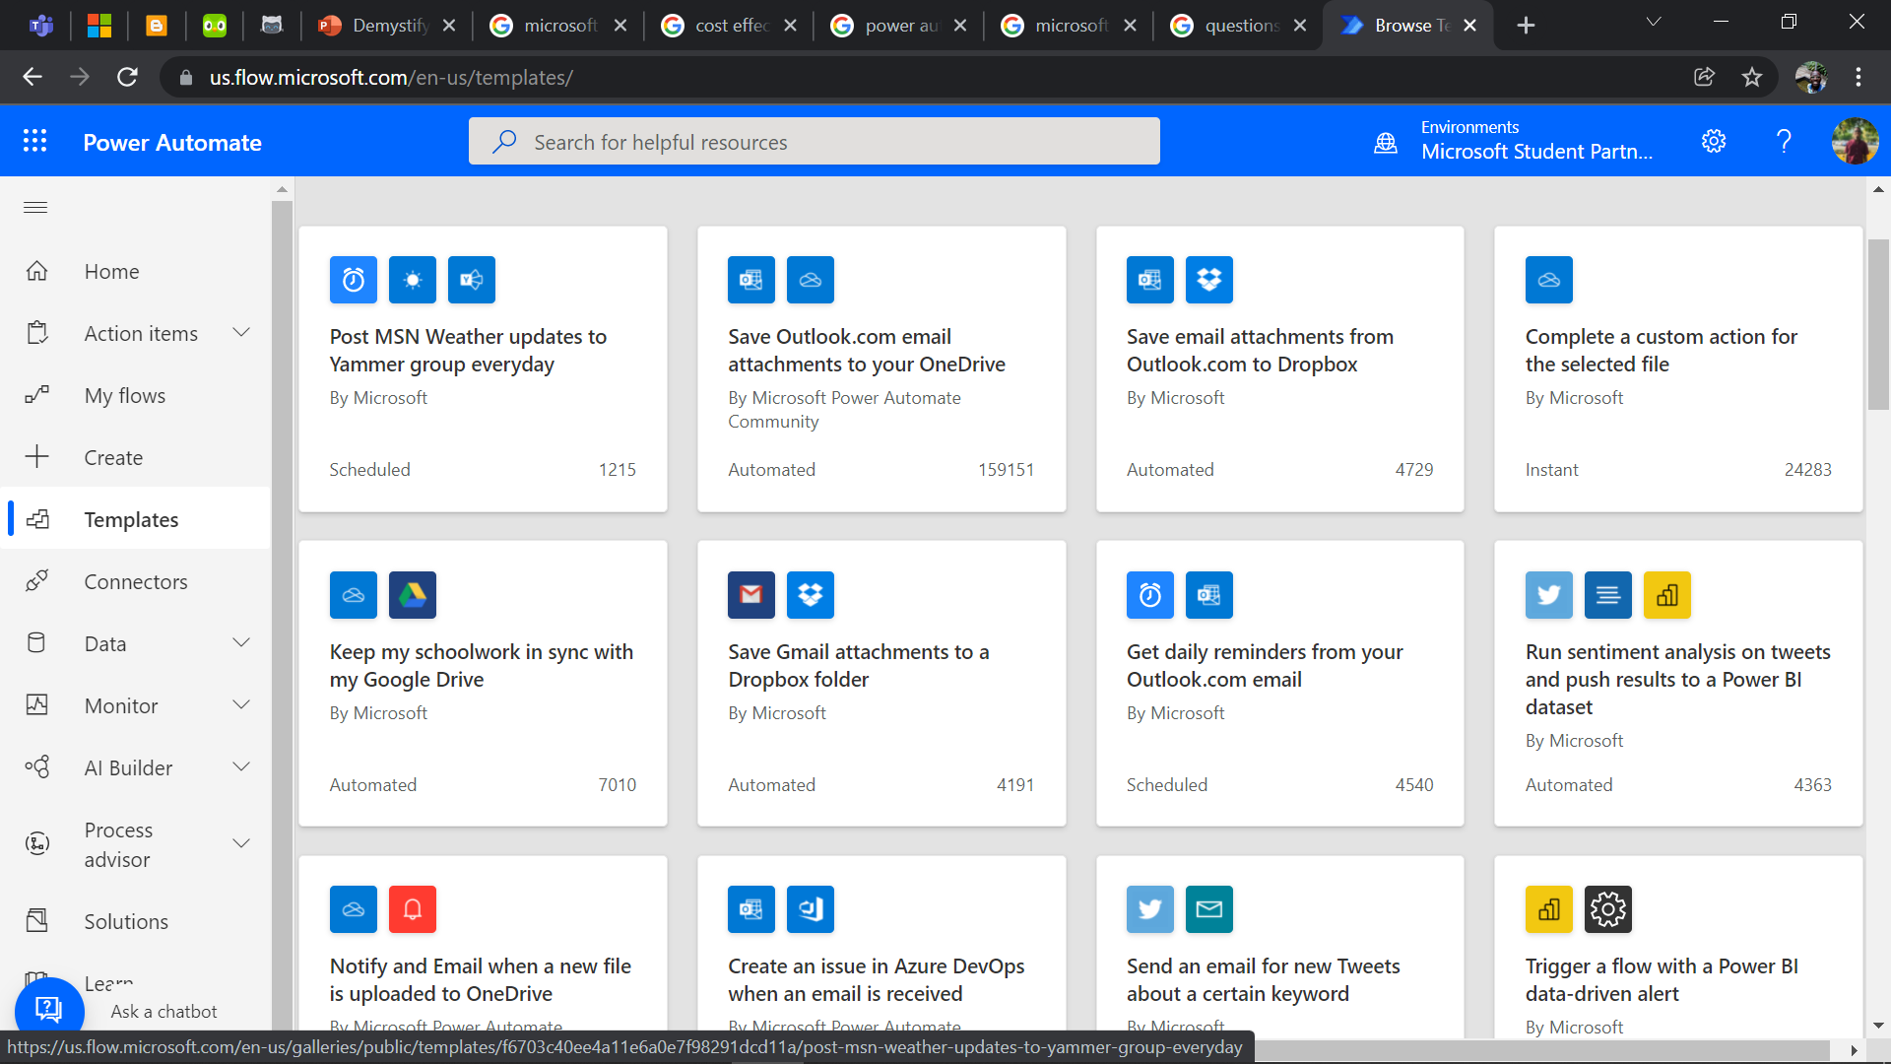

Slide 13
Types of flows
Cloud flows
Automated flows
Instant flows
Scheduled flows
Desktop flows
Business process flows

Slide 14
Why Power Automate?
Enables you to give your time to more important tasks
Eliminates repetitive tasks so you can do what you do best
Offers you endless possibilities with hundreds of connectors
Makes you powerful without any coding experience
Gets your back when you are away from your PC

Slide 15
Resources
Introduction to Microsoft Power Platform
https://docs.microsoft.com/en-us/learn/modules/introduction-power-platform/
Microsoft Power Platform Fundamentals
https://docs.microsoft.com/en-us/learn/paths/power-plat-fundamentals/

Slide 16
THANK YOU

